Slide 1
Kanban
Advanced Software Engineering

Slide 2
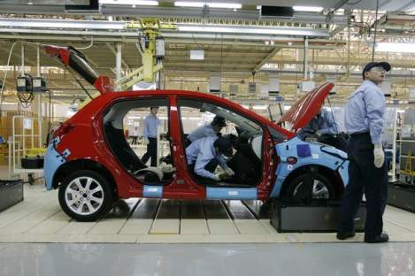
Kanban
The name 'Kanban' originates from Japanese, it means "signboard”, “billboard”
Used for Just in Time (JIT) manufacturing at Toyota manufacturing plants in Japan to limit the amount of inventory tied up in “work in progress” (WIP) on a manufacturing floor

Slide 3
Kanban
Kanban is a lean agile system that can be used to enhance any software development lifecycle including Scrum, XP, or Waterfall.

Slide 4
Principles
Start with what you do now
No specific set of roles or process steps
Agree to pursue incremental, evolutionary change
encourages continuous small incremental and evolutionary changes to your current system
Respect the current process, roles, responsibilities & titles
eliminate initial fears

Slide 5
Core Properties
Kanban promotes the lean concept of flow
to continuously and predictably deliver value.
The work and the workflow is made visible
to make activities and issues like backups obvious.
Kanban limits work in progress

Slide 6
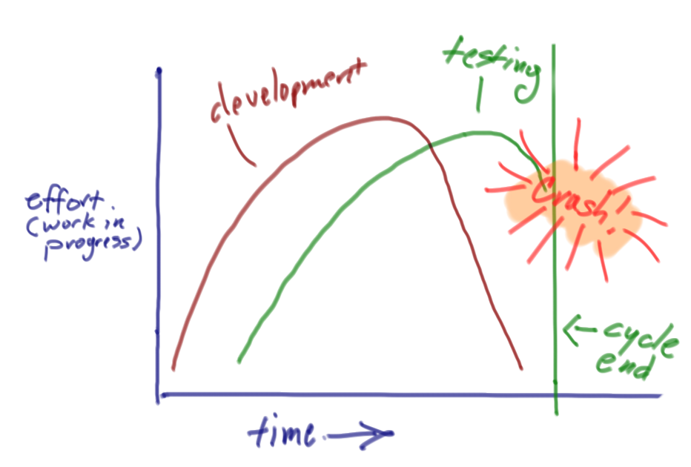
Inside an iteration, effort across roles is uneven
Development work often continues throughout a cycle while testing starts late and never seems to get enough time

Slide 7
Using a Kanban approach in software drops time-boxed iterations in favor of focusing on continuous flow.

Slide 8
SCRUM vs. Kanban
Kanban has less rules than scrum
Kanban is great methodology for Maintenance
teams that need to adapt to customer input on a daily basis.
Scrum is good for development that is heavily dependant on stakeholders' feedback
The sprint lock and the end of sprint demos to stakeholders

Slide 9
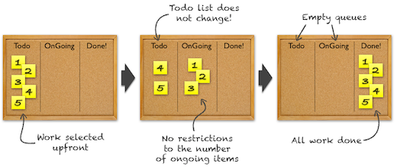
SCRUM vs. Kanban
In Scrum, you select the work you'll be doing for the next sprint beforehand. You then lock the sprint, do all the work, and after a couple of weeks - the usual sprint duration - your queue is empty.

Slide 10
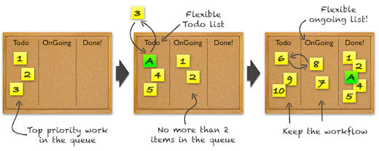
SCRUM vs. Kanban
In Kanban, all that's limited is the size of the queues, called the Work In Progress limit. This means that you can change the items in the queues at any time, and that there's no "sprint end". The work just keeps flowing.
Kanban flow, with a WIP limit of 3 for the Todo, and 2 for the Ongoing

Slide 11
Why limit the WIP?
Limiting WIP may have the following effects:
Reduces cycle time per task
Insures WIP is highest priority task
Reduces or eliminates queues between groups
Reduces multi-tasking by team members
Reduces lead times and increases quality

Slide 12
Work Process Flow
Analysis
Create specification and acceptance criteria
Product Owners
Development
Code features, fix bugs
Engineering Team
Test
Test features and bug fixes
QA Team
Merge and Deploy
Release features and bug fixes to customers

Slide 13
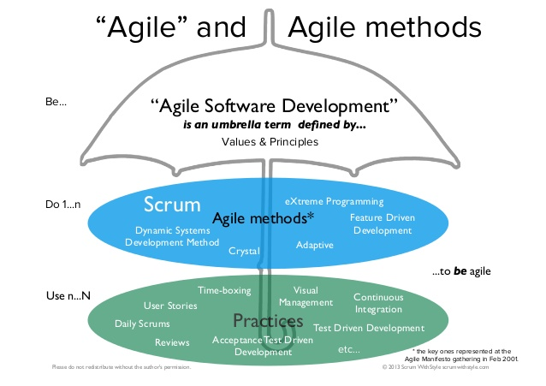
“LEAN”
“Lean value and Principles”
Kanban

Slide 14
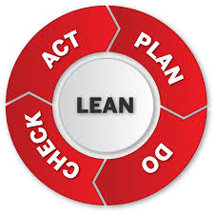
7 PRINCIPLES OF LEAN SOFTWARE DEVELOPMENT
Eliminate Waste
Empower the Team (Respect People)
Defer Commitment
Amplify Learning (Build Knowledge)
Deliver Fast
Build Quality In
See as Whole
Reference:
1. Poppendieck, Mary and Tom Poppendieck, Lean Software Development: An Agile Toolkit, Addison Wesley, 2003
Notes:
Definition - Anything not needed right now
Book Recommendation - Escape Velocity - Jeffrey Moore

Slide 15
Software Waste
Poppendieck’s 7 types of software waste
Partially done work
Extra processes
Extra features
Task switching
Waiting
Motion
Hand-offs; lack of co-located teams
Defects

Slide 16
Reference:
Anywhere from where you can get better knowledge

Slide 17
Q&A?

